Slide 1
Young people’s voices in the policy process:
Must we tell our own stories?
Cath Heinemeyer,
York St John University / York Theatre Royal
c.heinemeyer@yorksj.ac.uk
www.artsandnarrative.co.uk
www.storytellingwithadolescents.blogspot.co.uk

Slide 2
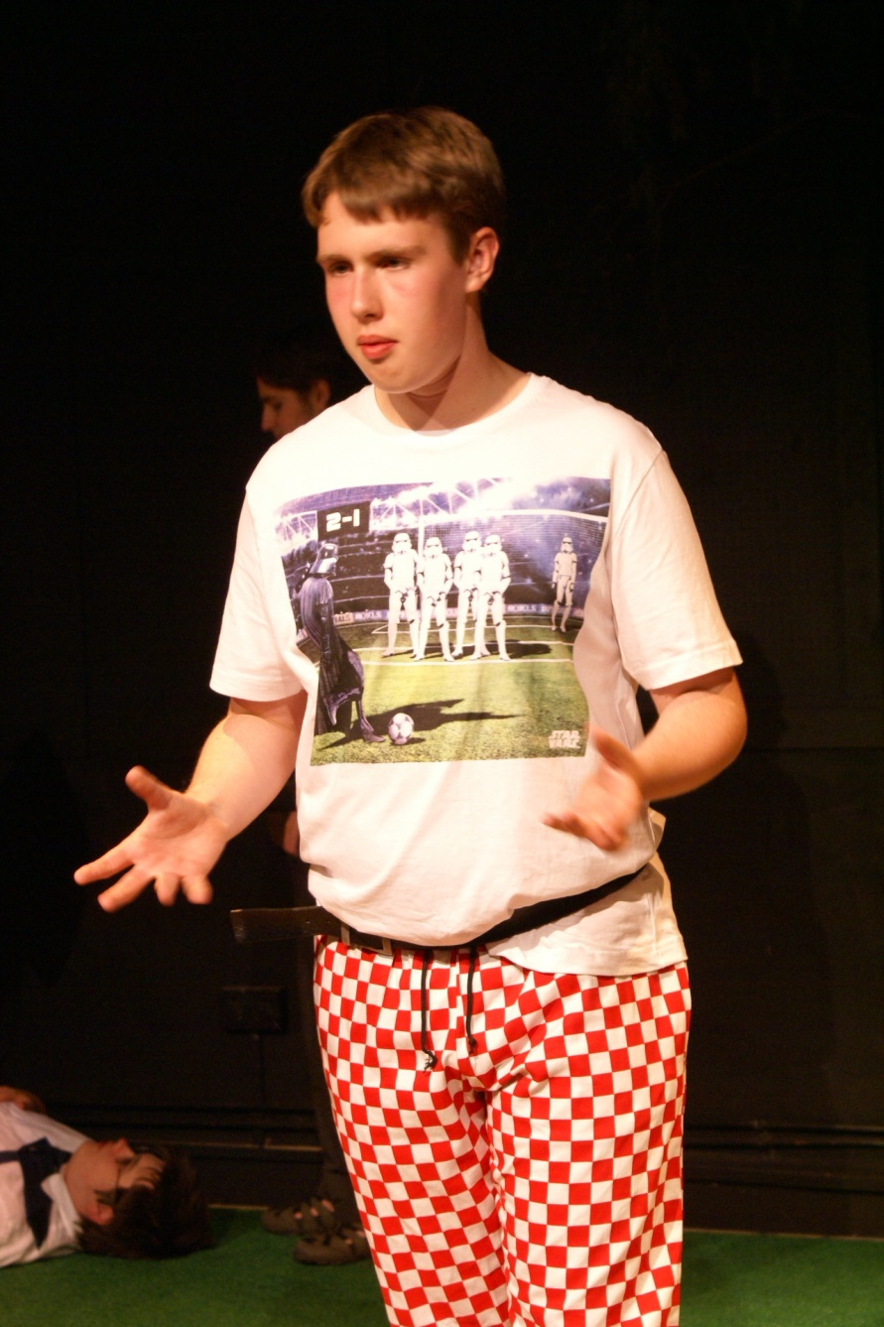
Whistle-stop intro to my research
Storyteller and educator focusing on sustainability and community
Practice-based PhD in storytelling with adolescents
Using mostly myth and folktale, and various artforms
AHRC-funded
In International Centre for Arts and Narrative (York Theatre Royal + York St John University)
Storytelling for, with and by teenagers in long-term partnerships in
a school,
a mental health setting,
various youth theatres
YSJU
a youth club

Slide 3
The ‘Discover’ enquiry – the true story!
Late 2014 – early 2015
Informing recommissioning of CAMHS services
Methodology: ‘appreciative enquiry’
Struggling to obtain young people’s input
Input from CAMHS residential unit not very appreciative

Slide 4
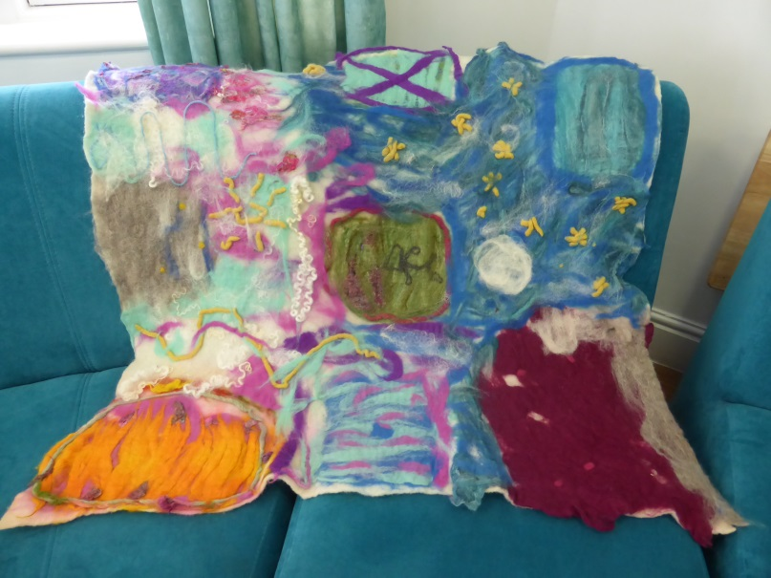
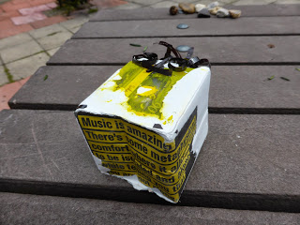
A digital storytelling approach
3rd person fictionalised narrative as a way of eliciting more considered, shared experiences?
Departure from my usual practice in setting

Slide 5
‘Role on the Wall’ → Rob(i/y)n
Add image of Rob(i/y)n
A ‘hollow’ figure and a fraught process
Play 0:00-01.57 of film.
Notes:
If we’re telling our own stories, then no compromise or twisting of them. Just enough to give anonymity. Effectively several different individual stories anonymised, topped and tailed. Still not very appreciative. Lots of conflicts in the process. But reflective and ultimately interesting material.

Slide 6
Voices in the policy process
Two young women keen to present film at professionals’ workshop
Response enthusiastic and respectful
Reinforced policy goals already identified by professionals:
Rapid access to support at early stages
Dismantling of ‘tier’ system & its hurdles
Better informed primary care, school, etc staff
Notes:
Maybe keen because of a day out of the setting, but also because they really did want to share their message of what had gone wrong in their care so far, the months of young life they had been robbed of.
From the professionals’ point of view, they were delighted to have successfully garnered the involvement of such relevant youth viewpoints, they were highly impressed by the young women’s eloquence, and although the criticism was fierce, it in fact reinforced policy changes they themselves had identified as needed. In this sense it added fire to their bellies and was undoubtedly a valuable input to the process.

Slide 7
My doubts
Timescale & nature of involvement dictated by Discover process
Did it in fact ‘fix’ patient identities? Rather than ‘open up’ their stories (Nick Rowe 2007)?
Did it enable them to say anything surprising?
Charlotte Gibb (2016) on communicating work with excluded people: ‘My experience of writing case studies for the programme has shown me that storytelling brings with it an internal tug of war. Does storytelling empower or dehumanise the people we support?’
Notes:
Increasing awkwardness at setting as project dragged on, desire to do something more fun. Difficult background for my relationships with patients. Did project fix ‘patient’ identities? Did it really permit them to say anything surprising? Cite Gibb. Or possibly even fix identities. Cite Rowe on ‘opening up’ stories.

Slide 8
Leo’s story
01:57-02:42 of film
Notes:
L’s story stood out from the others in being fantastical, hard to pin down, utterly unpragmatic. Lacking in policy prescriptions. A kind of refusal to tell his story, at least within the parameters set – and it took him weeks to decide whether to allow us to include even this. But intriguing, provoking questions – what could have crossed this distance L felt around him in CAMHS?

Slide 9
Tell your (trauma) story!
James Thompson: ‘Tell your story can become an imperative rather than a self-directed action….’ (2011:45) – a dominant ‘discursive system’ within applied theatre (2011:43)
Why?
For catharsis/narrative closure/de-traumatisation
To enable participants’ voices to be heard by those more powerful
‘Storyknowing’ conference: most papers on projects telling young people’s own stories
Notes:
Thompson does not condemn storytelling but feels that this imperative to tell one’s story of trauma a) has limits and b) arises from a seepage of psychological understandings of PTSD into community arts practice.
He identifies various reasons for this arising, and they fall roughly into two camps. On both scores he finds the ‘tell your story’ discourse to have unexpected negative side effects, and it is an argument you might be familiar with. I am concentrating today on the latter – did our Robin film enable the young people’s authentic voices to influence the policy process? Was it ‘legible’ to the policy process, did it really represent what they wanted to say?

Slide 10
Personal story as political capital
https://youngcarersrevolution.wordpress.com/poetry/
Gibb: ‘There’s a danger that caution can stifle the people we help, when we should be giving them a megaphone to make sure their perspective is heard.’
Dwight Conquergood (1985): dialogical engagement with voice of the subordinated ‘other’.
But is it a choice, as Thompson says, ‘to tell’ or ‘not to tell’? Or are there other ways?
Notes:
Essentially what we were doing was encouraging them to use their own stories as a form of political capital. This can be much more overt and less anonymised in other cases – e.g. Young Carers’ Revolution.
So what are the ethics of this? If they have lemons and choose to make lemonade, this is something we should facilitate. We should not shy away from helping young people to tell their stories. Nor should we oppose the personal narrative to the third person narrative – they are interwoven.

Slide 11
John’s Legend of Swimming
Notes:
I’d like to compare some other examples from my practice in this same CAMHS setting, creative collaboration through or around folktale, which I feel, in the broadest sense, also reflected individual young people’s desire to speak out and contributed to ‘policy’:
o The Legend of Swimming – within CAMHS unit, influencing other YPs and staff
o Wormwood – at Everybody’s Business conference, influencing mental health support in Yorkshire HE and FE.
John’s project – starting from ‘flooding’ – staff experiences – flood myths - personal memories of water. His escapade, how he enshrined it as a sort of myth. How he wanted to use it to communicate his worldview, the amazingness of this experience, the ‘circle of trust’ he had perceived – wanting to communicate this to staff and other young people. His ‘Positive News’, his desire that they understand the positive side of his psychosis. His song, allowing collaboration, teaching it to all. Wanting to send it to Minster FM.

Slide 12
Imogen’s ‘Wormwood in the Garden’
Presented at ‘Love Arts’ conference on arts & mental health, and Higher York’s ‘Everybody’s Business’ conference on mental health provision for under-25s
Notes:
VERY BRIEF - The writing workshop based on a story – Imogen’s engagement with this – her experience already as a poet. Her desire to create a performance out of this for Love Arts, infusing her poetry into it where she saw resonances with Wormwood’s odd story. Thus putting some of her own experience in here – but not her trauma narratives – rather her advocacy, her sources of hope, the knowledge she wished to share.
Focus on Everybody’s Business – how this forum was able to receive this as a policy intervention.

Slide 13
In conclusion
Can we always facilitate such opportunities for young people to speak through their artform? No.
Can all consultation processes digest such indirect inputs? No.
The communication they wish to make with the world, on their terms. Subtly. Artistically. Unpredictably. Like a story.
Notes:
Such things are unpredictable and likely to draw on young people’s existing talents and commitments. They won’t happen to order, and that’s maybe why they can’t be channelled into a policy process in the way Robyn could. However, we should be alive to such opportunities. Ready to ‘facilitate’ in an older sense of the word – make easier, smooth the way for them – rather than dominate the shape that their input takes.
Why? Because these inputs are insightful, subtle, essential. Maybe not as legible.

Slide 14
References
Conquergood, Dwight (1985) ‘Performing as a Moral Act: Ethical dimensions of the ethnography of performance’, Text and Performance Quarterly 5:2, pp.1-13
Gibb, Charlotte (2016) ‘The storytelling tug of war: do stories empower or dehumanise?’, at http://www.charitycomms.org.uk/articles/the-storytelling-tug-of-war-do-stories-empower-or-dehumanise , accessed May 2016
Rowe, Nick (2007) Playing the Other: Dramatizing personal narratives in playback theatre. London and Philadelphia: Jessica Kingsley Publishers.
Thompson, James (2011) Performance Affects: Applied theatre and the end of effect. 2nd ed. London:Palgrave Macmillan

