Slide 1
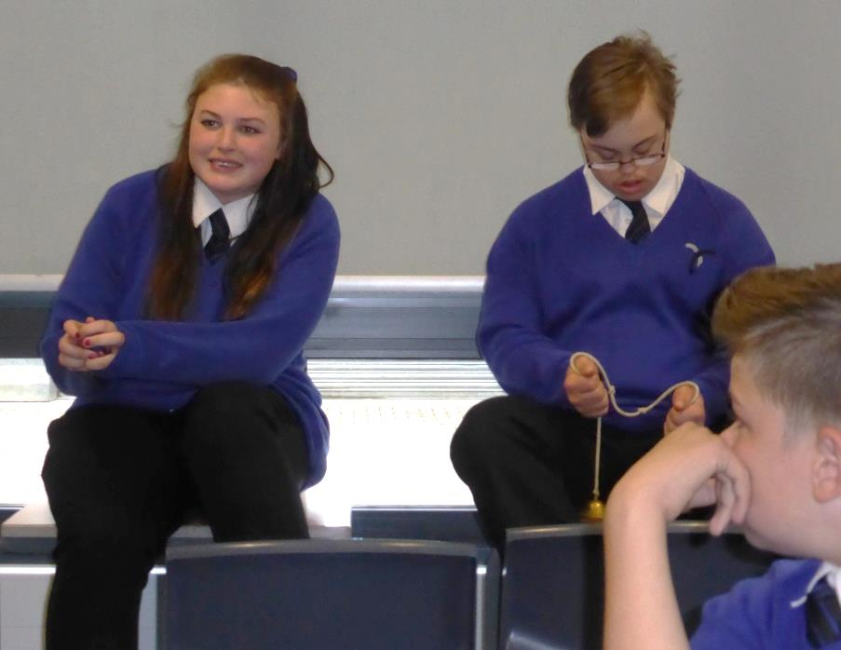
The school storyteller-in-residence: the power and the limitations of an ‘osmotic’ approach to disseminating PaR
Cath Heinemeyer
PhD student, York St John University / York Theatre Royal
c.heinemeyer@yorksj.ac.uk
www.storytellingwithadolescents.blogspot.com
www.artsandnarrative.co.uk

Slide 2
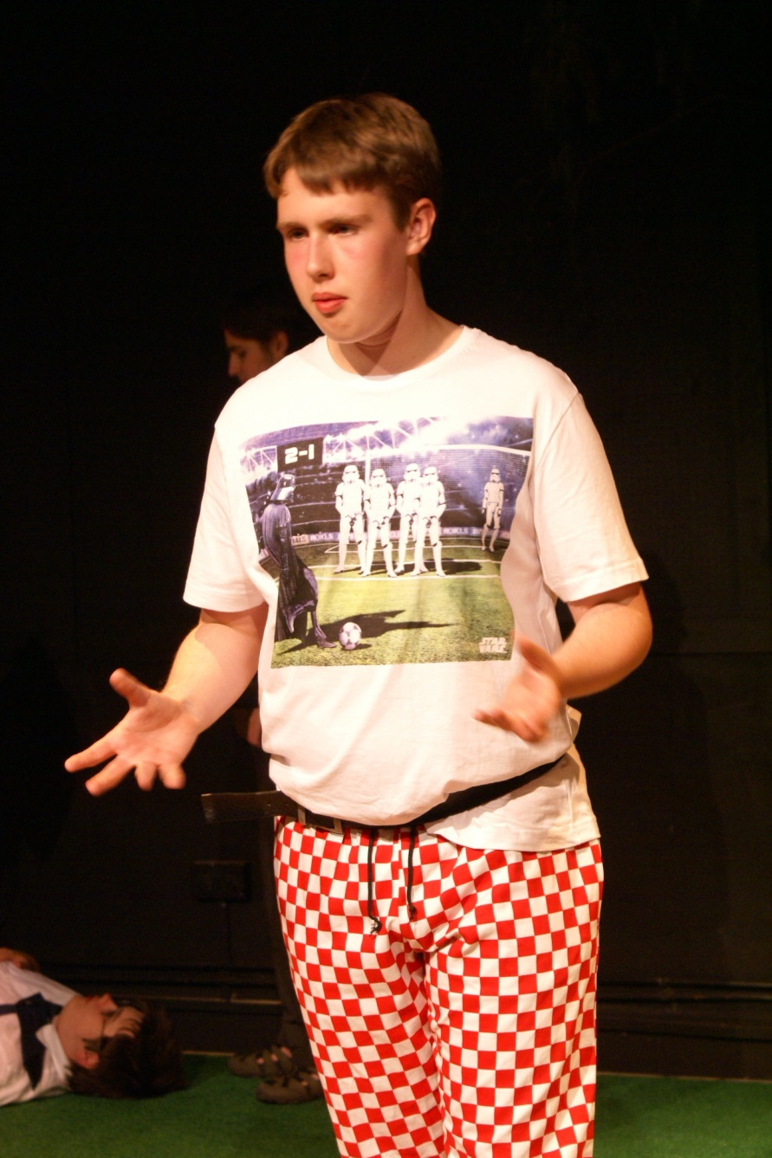
Whistle-stop intro to my research
Storyteller and educator focusing on sustainability and community
Practice-based PhD in storytelling with adolescents
Using myth, folktale & stories based in fact
AHRC-funded
In iCAN (York Theatre Royal + York St John University)
Storytelling for, with and by teenagers in long-term partnerships in
a school,
a mental health setting,
a drama club,
a youth club.

Slide 3
The secondary school ‘residency’
Based in inclusion, humanities and communication departments
In-depth, long term practice and research collaboration with one KS3 inclusion humanities teacher (Nov 2013 – ongoing)
Short projects in English lesson time (Feb-Apr 2014)
A weekly lunchtime storytelling club (Sept 2014-May 2015)
Mentorships for talented pupils
Workshop at Theatre Royal’s iCAN centre
TA training session

Slide 4
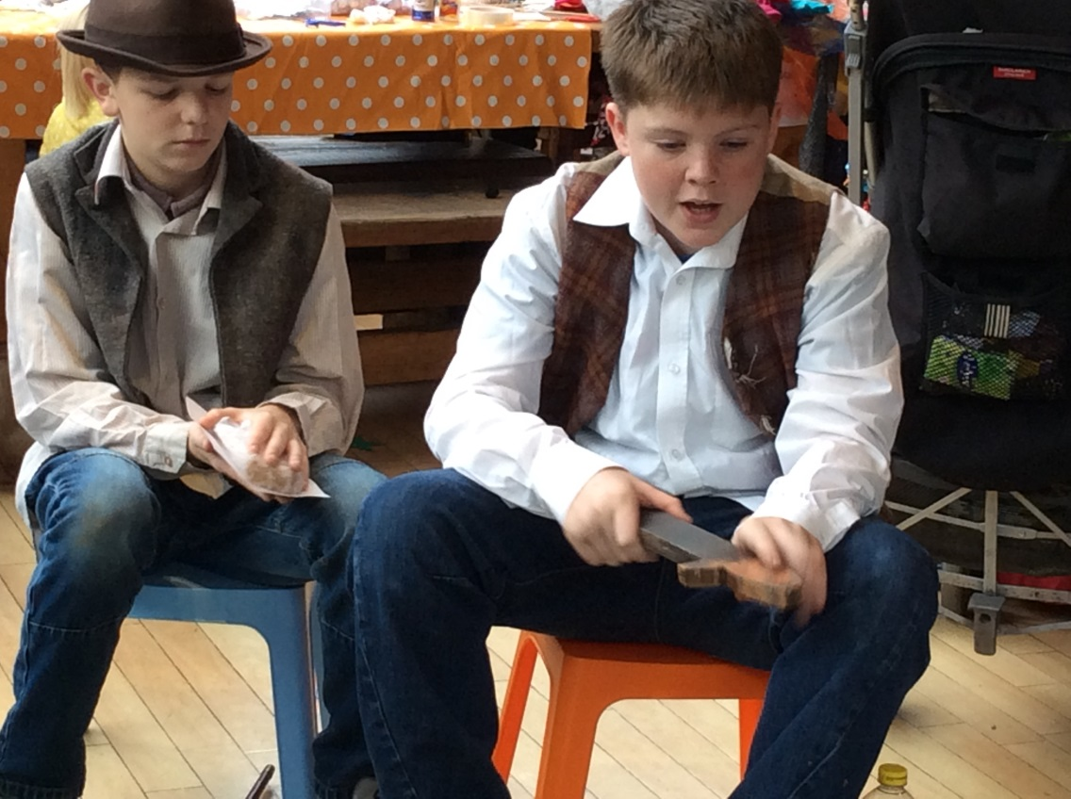
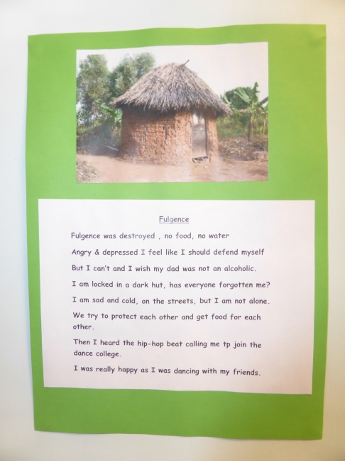
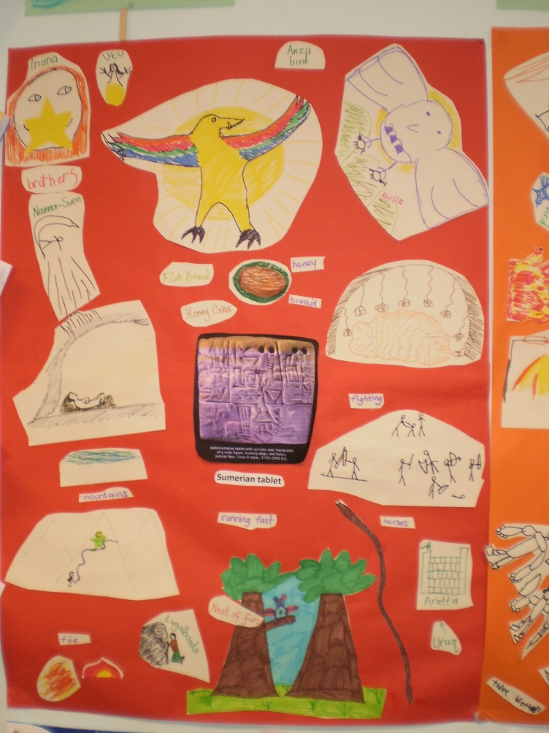
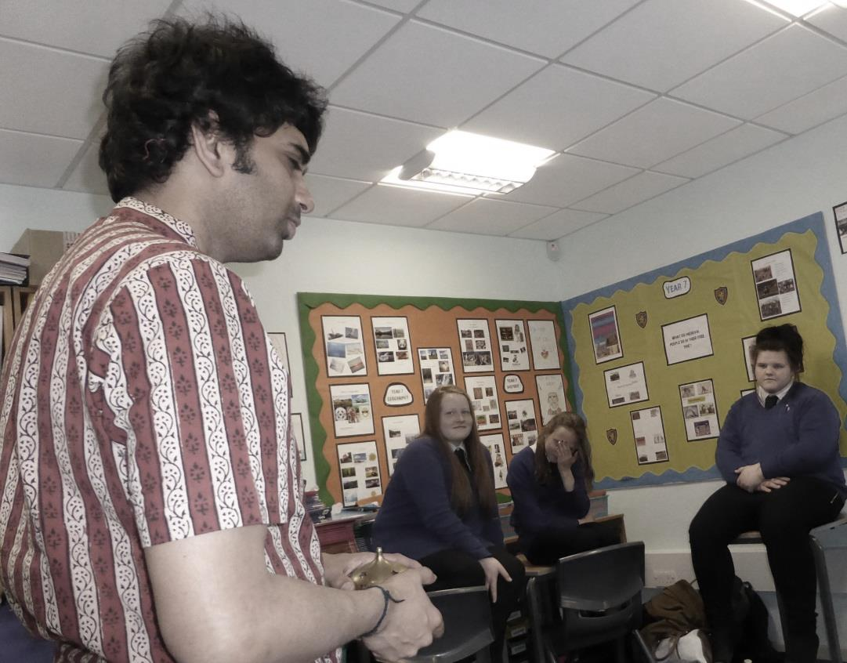
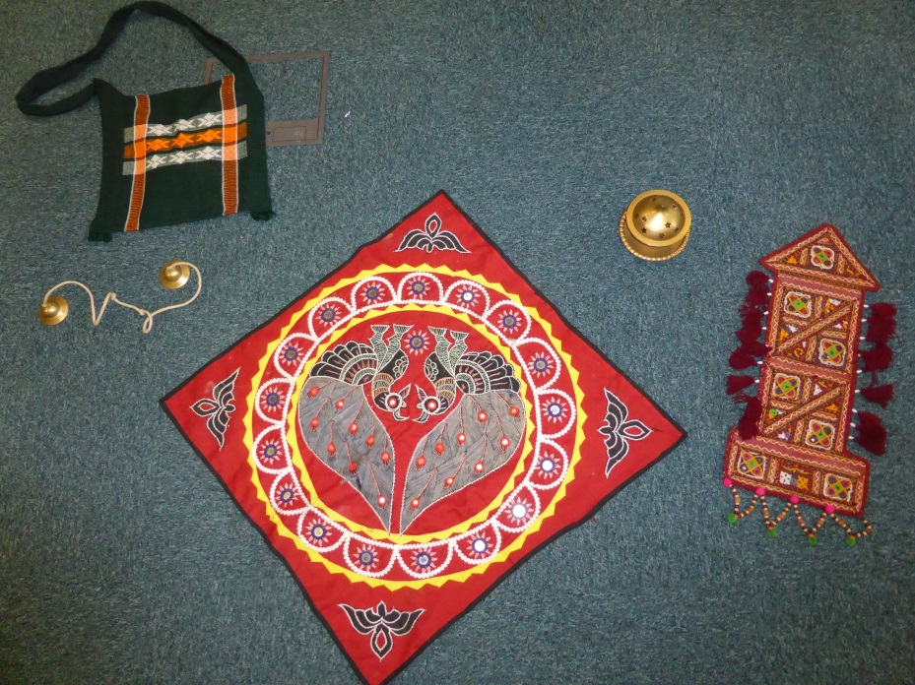
Notes:
This is in fact a rather huge and extremely diverse body of practice.

Slide 5
How to measure impact of this work?
Or, in what sense is this actually research?
Or, what impact am I aiming to have:
On these particular young people?
On this school or its teachers?
(more grandiosely) on education policy in general?
Or just on my own practice?
Three possible alternative approaches

Slide 6
A quantitative/qualitative assessment of benefits

Slide 7
“the arts, which constitute a policy area commanding small budgets and little political clout, have progressively attached themselves to economic and social agendas…” (Belfiore and Bennett 2010, p.121)
Leading to a “quest for a straightforward method of impact evaluation, easily replicable in different geographical contexts and equably applicable to different art forms and diverse audiences” (p.122)
From the 75+ sessions I have led in this school, with approx. 200 pupils, there should be some measurable impact on literacy, cultural awareness, self-esteem, social skills etc.
Indeed, say Belfiore and Bennett (2010), scholars objecting to the instrumental notion of arts impact have been reluctant to engage with administrative research – leaving the field free for those with a positivist view to dominate.

Slide 8
But is this not a monologic view of impact?
Stern (2015): Considering young people (or teachers) either as separate individuals, or as a collectivity upon whom certain effects can be wrought, is problematic.
Rather I would like to consider voices of pupils, teachers, visiting storytellers, politicians as engaged in some form of dialogue within the policy arena.
Notes:
And of course the impact of these people on me and my own practice.

Slide 9
And is this really how evidence informs policy?
“The studies also found that decision makers believed that they were influenced by policy-oriented research. Often they could not cite the name of any particular study and many of them could not even remember reading a research report. But in circuitous ways research findings came into circulation and ideas from research percolated into the policy arena…And people had the sense that they had heard generalizations from research and that these ideas had influenced their thinking.” (Weiss 1995, p.141).
Using a discourse analysis perspective (Sutton 1999) to extend this to PaR: policy and implementation not two separate fields.
Might even the practice of communities of individual educators suggest new narratives of education, or challenge dominant discourses?
An ‘osmotic’ approach to impact?
Notes:
It is not my experience that individual teachers, or individual policy makers, make decisions based on large empirical studies. Rather they are impressed by contacts, experiences they have had. By stories, indeed.

Slide 10
Osmosis – a mutual and dialogic approach to impact

Slide 11
Mechanisms of osmosis
Classroom collaboration – the co-creation of each workshop in planning and implementation
Making tacit knowledge explicit:
staffroom ‘chat’ and value articulation
Co-developing explicit pedagogy in collaboration and discussion with main teacher contact
Training session for teaching assistants
Gift-giving, e.g. opportunities for talented pupils
Articles for school newsletter
Sharing of artefacts produced in sessions
School assemblies
Notes:
These are the mechanisms of osmosis in practice.

Slide 12
The development is the dissemination
Developing a pedagogy of storytelling in this school
Influenced by
Stern’s (2013) emphasis on the need for mutual ‘surprise’ in education,
Buber’s (1958) on the need for dialogue between ‘I’ and ‘Thou’ within institutions,
Bakhtin’s (Morris 1994) view of knowledge creation as dialogic and heteroglot,
Guattari’s (1995) idea of ‘chaosmosis’ and the re-subjectivisation of institutions

Slide 13
A story-based pedagogy
Starts with the whole story…
…Which is then…
Told by me to you
explored through a variety of artforms
Sparsely
But rich in sensory detail to bring you there and broaden your experience
leading to retellings in which you ‘fill in the gaps’
communally
‘showing my working’/research
using and celebrating your life experience
and drawing on my life experience
a sort of dialogue of life experience within the ‘other room’ of the story
Stitching your knowledge to your experience
creating a lasting shared knowledge resource for the class
and a template for respectful dialogic communication
…usually
Bishnoi man establishing a sacred grove
Notes:
USUALLY is important here. The storytelling relationship of uncoerced mutual attention is the model for this pedagogy. This relationship breaks down if attention is forced or over-structured. The listener’s attention is given as a gift. When it works, there can be huge gains of experiential understanding, self-esteem, quality of listening and understanding. But if they do not consent, it can break down into relative chaos.

Slide 14
This pedagogy was constructed in/by a field of conflicting ideologies
‘the sensitivity of one language to those surrounding it…results not in peaceful relativity, or inert coexistence, but in a clash of discourses, as Bakhtin emphasises:
The authentic environment of an utterance, the environment in which it lives and takes shape, is dialogized heteroglossia…(Bakhtin, ‘Discourse in the Novel’, p.272)’
(Vice 1997, p.49)

Slide 15
Synergies between story-based pedagogy and current educational thinking
Emphasis on creativity, fluidity and responsiveness, e.g. in ‘Moving English Forward’ (2012)
Restatement of importance of texts and narrative
Oral rehearsal and moves away from IRE
Higher-level thinking skills in low-ability classes
Moves to longer-term approach to assessing progress
(Nicola Towle, pers. comm., and S.D., pers.comm.)

Slide 16
Conflicts between story-based pedagogy and current dominant teaching approaches:
‘The whole story’
vs active reading / active listening
Creative extension
vs skills-based teaching
Open-ended dialogue
vs structured approaches to classroom communication (e.g. basketball thinking)
Communal knowledge construction
vs pace, progress and planning
Relationship of gift and risk-taking
vs excellent behaviour and learning objectives
The landscape
vs the road
Pupil in focus group: You know when you’re telling a story and some of us put our heads down like that – it’s only because some of us do it to, like, picture the images in our heads.
Notes:
The conflicts are not primarily of content but of process. NB. I am talking mostly about the English and humanities curriculum here. I am sure you as an education audience could add more to these lists.

Slide 17
Or is this a one-sided infiltration?
Finding and prising open gaps in institution
But gaps are small and in fact short-lived (for reasons circumstantial and nonetheless systemic)
Risk aversion makes system relatively impermeable and story-based pedagogy runs against its dominant grain
Thus primarily a compensation for otherwise necessarily target-focused lessons
Mr K on feedback form: “The pupils need a creative spark, we’ve been very methodical this year”
Ms T: “When I started 9 years ago as an NQT it was all about narrative and creative writing, now it’s mostly factual. Their creative writing is wildly unrealistic.”
Ms C: “They have obviously enjoyed the opportunities to engage in the sessions. They didn’t really support skills but did allow the pupils to enjoy their creative sides…. It doesn’t seem especially useful in terms of being focused on assessments, etc.”
Notes:
Give details of shutting down of opps – SD’s retirement, half-hour lunch breaks putting paid to lunch club.
Important to note that these gaps have shut down IN SPITE OF teachers’ efforts to hold them open for me. In a less constrained education system, I do think the osmotic approach is potentially very powerful. For example, in my work in an adolescent mental health setting opportunities have not closed but opened and opened. Gaps have enlarged and the institution has actively helped the work to flourish. The local policy world has responded and sought to find more out about it. Meetings have been held with senior service managers.

Slide 18
Notions from relational aesthetics – the Temporary Autonomous Zone, the microtopia

Slide 19
‘The work of art as social interstice’
‘An interstice is a space in social relations which…suggests possibilities for exchanges other than those that prevail within the system….’ (Bourriaud 1998, p.44)
Rather than gesturing towards a future educational utopia, the sessions aim to create a ‘microtopia’ there and then.
An acceptance that the pedagogy is too oppositional to exist outside a Temporary Autonomous Zone. It may not significantly ‘infect’ mainstream practice, but may leave other traces – surprises, interests, desires, realisations, expectations, relationships, templates, provocations.

Slide 20
The co-created microtopia
Cath: Is storytelling a kind of metaphor for the way you run your classroom?
SD: I had not thought of it in this way at all and I thank you for drawing my attention to it. You see I work in a very instinctive way most of the time and do what I feel is right. The way I run my classroom feels right to me. I try to provide my pupils with a safe environment where they can trust that their views and opinions will be respected by me and their peers.
I try to encourage those pupils with low self esteem, low confidence levels, speech difficulties etc to speak out with confidence. I hope that I have been able to give each of them the time to formulate a reply and the time to verbalise it. This is a problem sometimes as other pupils are not always willing or able to give the speaker that time. It is a lesson in life for them, patience and respect for other people to have their say and for them to listen and respond when it is their turn! There is a concentration of these skills during the storytelling sessions! So I would say that yes, storytelling sessions are a metaphor for the way I run my classroom.

Slide 21
One day over a year ago
A year later:
Cath: What would be your favourite story, or your favourite activity that we’ve done?
J: Mr Imagination…cause he had imagination.
S: Whatever he thought of came to life. He thought of lions, and they came to life, and they started attacking him. So he thought of cages.
C: Was it because it was something your whole class made up together?
J: Yes.
D: He imagined stuff, like…anything he decided, he could do.
S: Do you want me to read what this says? There’s a boy. He never gives up. He saves people. He’s determined. He imagines dangers. He tries his best. He’s kind, helpful, strong, courageous, wit.
J: Handsome-looking?
S: Yep! (LAUGHTER)
C: Let’s have a vote – was Mr Imagination handsome?
J: Ugly!
S: Well, I thought of him having fiery hair…
Notes:
Explain genesis of Mr Imagination – out of Poia and William Kamkwamba.

Slide 22
Be in touch!
c.heinemeyer@yorksj.ac.uk
www.storytellingwithadolescents.blogspot.com
www.artsandnarrative.co.uk

Slide 23
References
Buber, Martin (2013(1958)) I and Thou, 2nd ed., tr. R.G. Smith. London: Bloomsbury Revelations
Belfiore, Eleanora and Bennett, Oliver (2010) ‘Beyond the “Toolkit Approach”: Arts impact evaluation research and the realities of cultural policy-making’. Journal for Cultural Research 14:2, pp.121-142.
Bourriaud, Nicolas (1998) Relational Aesthetics. Les presses du reel.
Guattari, Felix (1995) Chaosmosis: an ethico-aesthetic paradigm, tr. Paul Bains and Julian Pefanis. Bloomington: Indiana University Press.
Morris, Pam (ed.) (1994) The Bakhtin Reader: Selected Writings of Bakhtin, Medvedev, Voloshinov. London: Arnold.
OFSTED (2012) Moving English Forward: Action to raise standards in English, accessed at https://www.gov.uk/government/uploads/system/uploads/attachment_data/file/181204/110118.pdf, 16 February 2015.
Stern, J. (2013) ‘Surprise in Schools: Martin Buber and dialogic schooling’, FORUM 55 (1): 45–57.
Stern, Julian (2015) ‘Children’s Voice or Children’s Voices? How educational research can be at the heart of schooling’. FORUM 57:1, pp.75-90
Sutton, R. (1999) The Policy Process: An Overview. Working Paper 18 for Overseas Development Institute, accessed at http://www.eldis.org/vfile/upload/1/document/0708/DOC7279.pdf, 18 February 2015.
Vice, Sue (1997) Introducing Bakhtin. Manchester: Manchester University Press.
Weiss, C.H. (1995) ‘The Haphazard Connection: Social Science and Public Policy’, International Journal of Education Research 23:2, pp.137-150

